Slide 1
Manage Up! Techniques for Driving Cross-Team Efficiency in Grant Seeking
Presented by Abby Teare & Kelly Howard

Slide 2
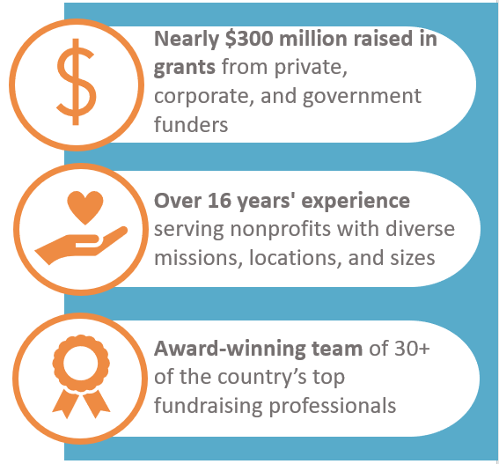
About Grants Plus
Grants Plus is the nation’s most trusted and experienced professional grant seeking firm.
We partner with nonprofit organizations as their trusted advisors to find grant opportunities, guide funder relationship building strategies, write compelling grant proposals, and make long-term grants gains.
Notes:
ABBY
At Grants Plus, we see our role as going beyond simply writing proposals to that of trusted advisor at every step of the grant seeking process.
Have raised a quarter of a billion dollars to support the missions our clients
Celebrated our 15th anniversary this year
Started in Cleveland and have grown to a national team of 30+ grant experts – our knowledge base of funding trends has increased exponentially as we’ve added team members across the country.

Slide 3
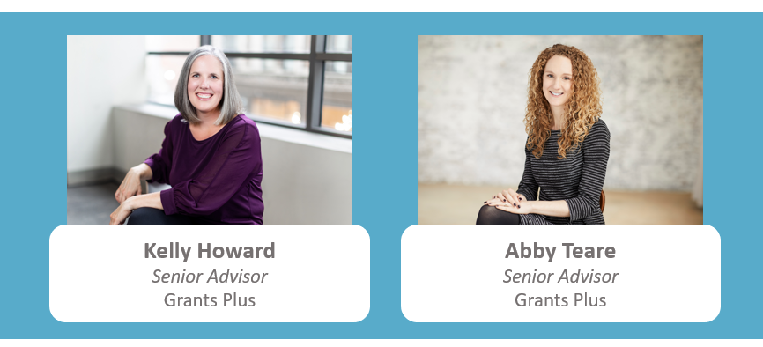
Meet Your Presenters
Notes:
ABBY:
10 years of experience working in and with nonprofit organizations
Started as an in-house grants manager and moved into consulting about 4 years ago
At GP, work with a variety of clients ranging from arts and culture and historic preservation to health and human services and community development
In role as a Senior Advisor, I have helped shape our firm’s standards for excellence in grants strategy and am involved in innovating across our prospect research service lines
KELLY:
20+ years of experience as a grants professional
Worked for a variety of nonprofit organizations as an in-house grant writer – domestic violence/sexual assault, homelessness, workforce development, and arts and culture institution
Worked in a variety of geographies – Des Moines, Kansas City, Washington DC, St. Louis
Joined the GP team a little over a year ago
There, work with a variety of clients with various missions and support them in their grant-seeking efforts
As Senior Advisor for Writing, provides coaching and support for internal staff on best practices in writing and improving writing quality
Has served on the St. Louis GPA board of directors and served on the marketing/membership, program, and chapter conference committees

Slide 4
What makes today’s topic so important?
Notes:
ABBY
We are here today…
To focus on something that is the #1 priority to all of us: WINNING more grants!
Working at Grants Plus gives us the vantage point of working with so many nonprofit organizations and understanding what makes grant seekers successful
Regardless of mission, size, staff, budget, etc.
We know that a winning proposal depends on presenting a clear vision, a compelling case, and a strategic ask.
BUT we also know that it’s not all about what’s happening in the grant proposal.
It’s also about what is happening in the organization!
Many otherwise successful grant seekers struggle to be successful in grant seeking when internal challenges get in the way. Some of these problems can include:
Program and leadership staff who are disconnected from the grants process
Ineffective and indirect communication that doesn’t get the job done
Unreliable information
Challenges related to manage deadlines and decisions

Slide 5
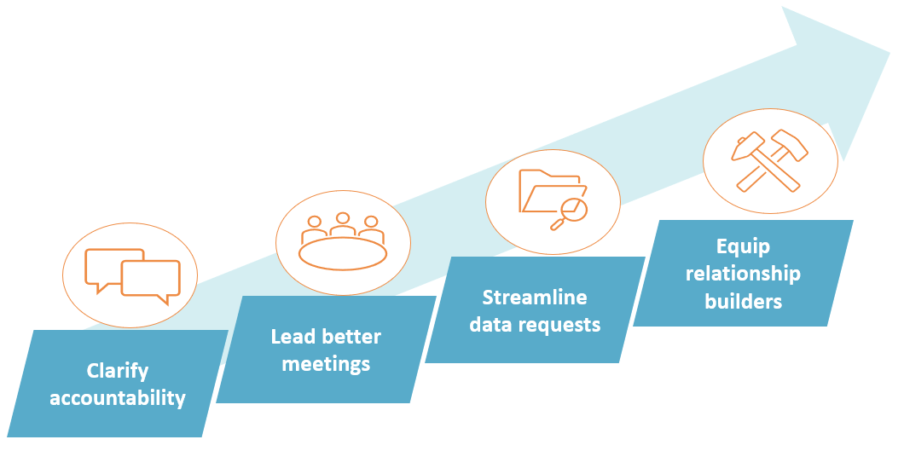
Learn Techniques to “Manage Up”
Notes:
ABBY
The good news is that whether you are a grants professional working in house within a nonprofit organization, or a grants consultant working with multiple organizations, you have an opportunity to influence these factors.
How? By learning and practicing strategies to “manage up” with peers and decision makers. Today we are going to share techniques that we apply to our own experience working with nonprofit leaders across the country to improve communication and process for seeking grants.
These techniques include:
Clarifying accountability (note to presenters: the point of ARCI is improving clarity/driving clearer communication)
Leading better meetings
Streamlining data request
Equipping relationship builders
From our own experience, we have confidence that you can “manage up” to inspire better internal process that will lead to less frustration and more successful grant proposals.

Slide 6
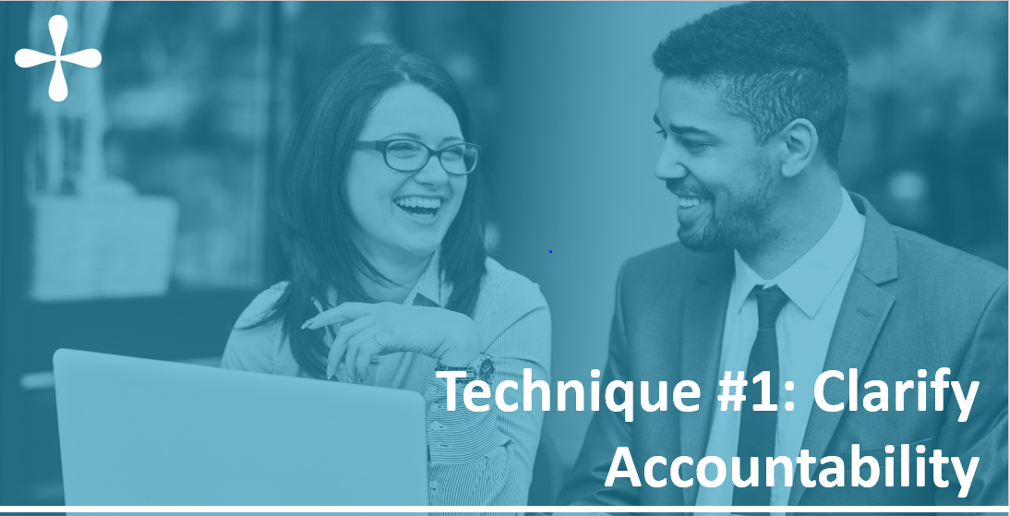
Notes:
KELLY
Accountability is critical to strong teamwork
A critical aspect of accountability is effective communication
Also important to accountability is clearly defined roles and responsibilities
Especially important in the grants world, where we as grant professionals depend on the time, knowledge, and resources of other people to do our jobs as best and most effectively as possible
Building accountability within the dynamics of our teams, organizations, partnerships, client relationships, etc. helps us to write strong, successful grant proposals
When there is lack of clarity around roles and responsibilities and who is accountable for what, it’s more likely a team will not succeed in preparing a grant proposal that will be compelling to a funder
There are two frameworks we employ at Grant Plus to support strong teamwork, both with clients and each other.
SDR
ARCI
We’re going to dive into both as the first technique in our managing up “toolkit.”

Slide 7
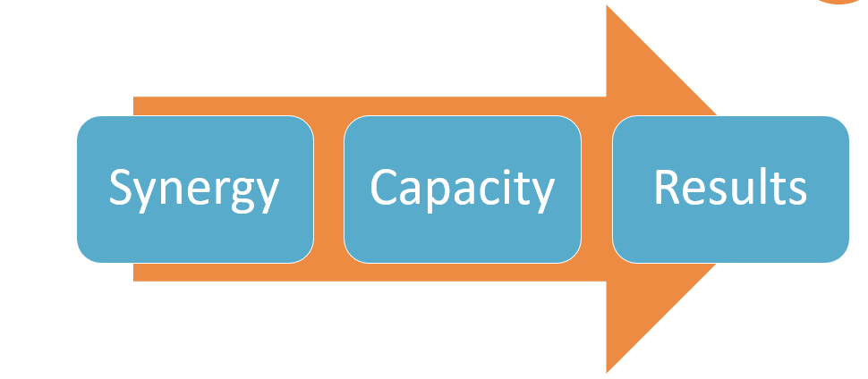
Effective communication drives…
Notes:
KELLY
The first is a framework for effective communication
Effective communication builds trust and cooperation, or synergy among team members; in other words, we want our teams to be collaborative, to have shared understanding, and to work in cooperation)
Gives the team the capacity to achieve the results it set out to accomplish

Slide 8
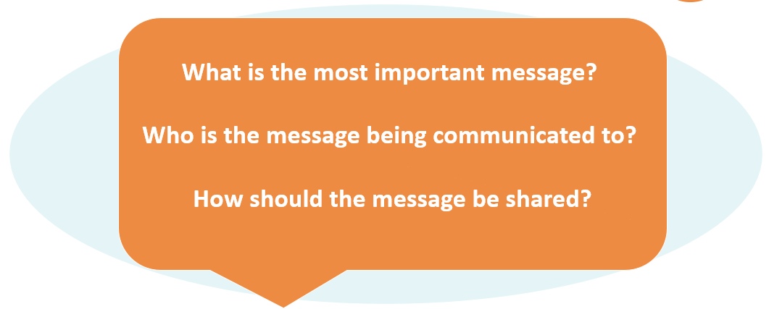
Simple, Direct, Respectful Communication
Notes:
KELLY
Effective communication is the center of our work:
Approach all conversations through the lens of simple, direct, respectful communication.
We also refer to this in shorthand (because we all love a good acronym) as SDR communication.
Too often, we send an email or enter a meeting without taking time to consider:
WHAT is our most important message?
WHO are we are communicating with?
HOW should we share the message?
The SDR framework requires us to be more keenly aware of:
What the most important part of the message is
Who we are talking to
How we are communicating the message to those people
The principles of SDR communication can help you reflect and properly address each of these questions to work toward clarifying accountability in your team.

Slide 9
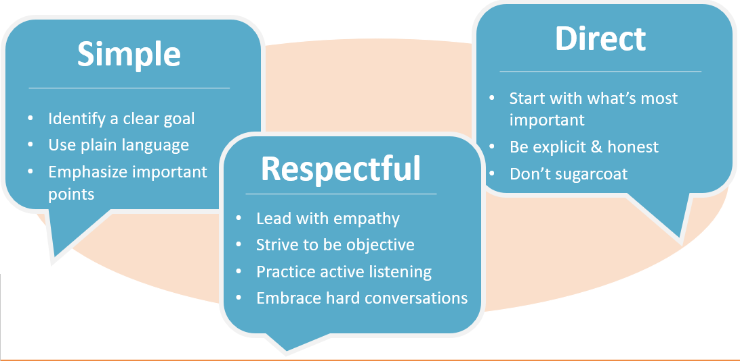
Notes:
KELLY
Let’s break down what simple, direct, and respectful communication means.
Simple:
Having a clear understanding of your goal
Communicate using plain language
Emphasize important topics
Direct:
Lead with what is most important
Say what you mean, which means being explicit and honest
Make it easy for your reader/listener to follow along and understand
Respectful
Lead with empathy and understanding
Strive to be reasonable and objective
Be an active listener in your interactions
Embrace hard conversations with a positive attitude and with curiosity to learn more about the other side

Slide 10
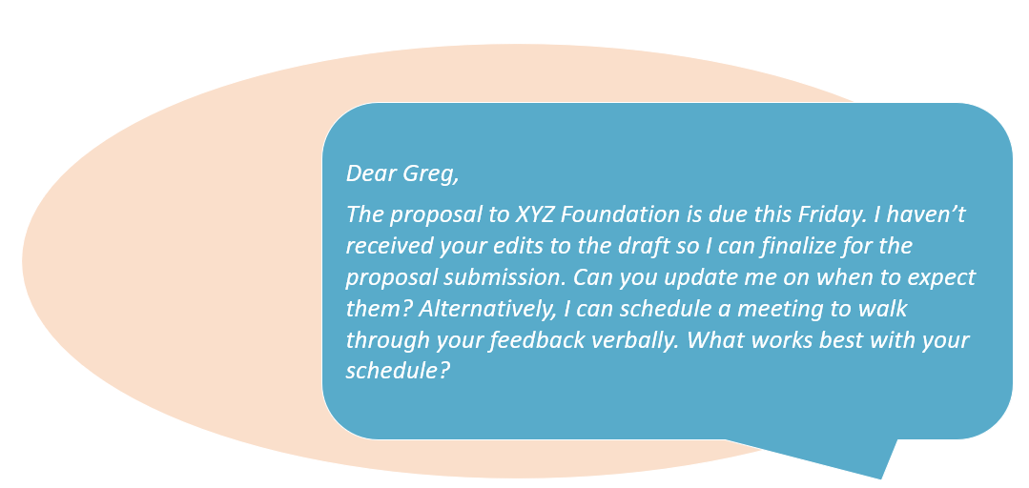
SDR in Practice
Notes:
KELLY
Here’s an example of simple, direct, respectful communication in action. (Read example).
Sample of an email that this person has written to a colleague or client to check in on the status of his review of a proposal:
Uses plain language and emphasizes the most important point (upcoming deadline and proposal hasn’t been edited)
Explains what is most important and is honest (getting edits/feedback)
Is reasonable and offers solutions in a respectful way (provide edits and update OR schedule a meeting to go through feedback verbally)
This example is an email, but SDR can be utilized in in-person conversations, phone calls, and all types of communication.

Slide 11
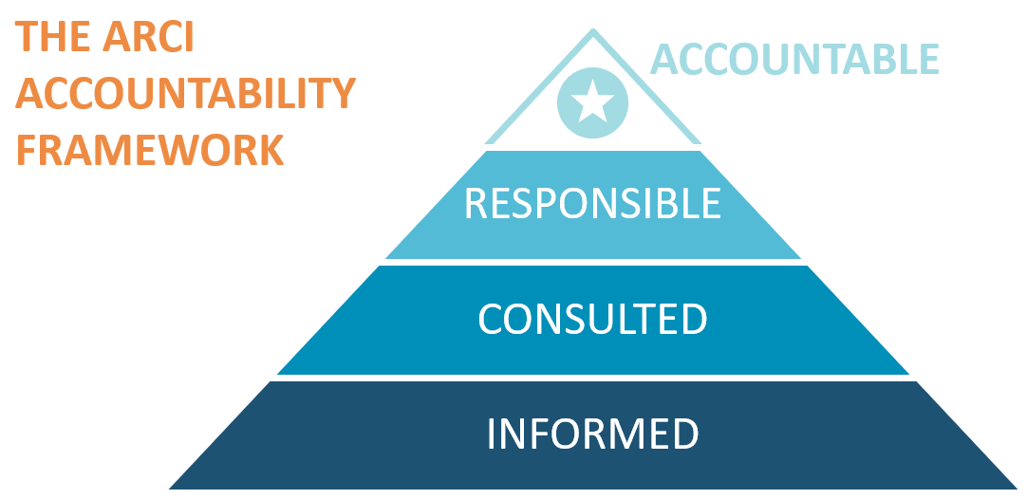
The ARCI Accountability Framework
Notes:
KELLY
The second framework is known as “ARCI”
We approach company functions and projects according to the ARCI approach
Acknowledges that a single designated person must be accountable, even while others may also be involved in the outcome
Accountable – at the top of the pyramid:
The “owner” of the work.
They must sign off or approve when the task, objective, or decision is complete.
This person must make sure that responsibilities are assigned in the matrix for all related activities.
There is only one person accountable, which means “the buck stops there.”
In our work as grants professionals, we are often the Accountable party in getting a proposal written, finalized, and submitted on time.
Responsible – next level of the pyramid:
The “doers” of the work.
They must complete the task or objective or make a decision to help the Accountable person bring a project to completion.
Several people can be jointly responsible for various aspects or tasks within the project.
In our work as grants professionals, the Responsible parties are often program managers, direct service staff, finance staff, etc. – whoever you rely on to get the information you need.
Consulted – one more level down on the pyramid:
These are the people who need to give input before the work can be done and signed-off on, but don’t own the project and aren’t necessarily responsible for any specific tasks.
These people are “in the loop” and are considered active participants.
In our roles, this is most likely a Director of Development or Chief Development Officer who reads and approves a final draft before submission; maybe a director of finance who signs off on the budget; or even an Executive Director.
Informed – this is the bottom layer of the pyramid:
The people who need to be kept “in the picture”.
They need updates on progress or decisions that have been made that impact the project, but they do not need to be formally consulted.
Nor do they contribute directly to the task or decision.

Slide 12
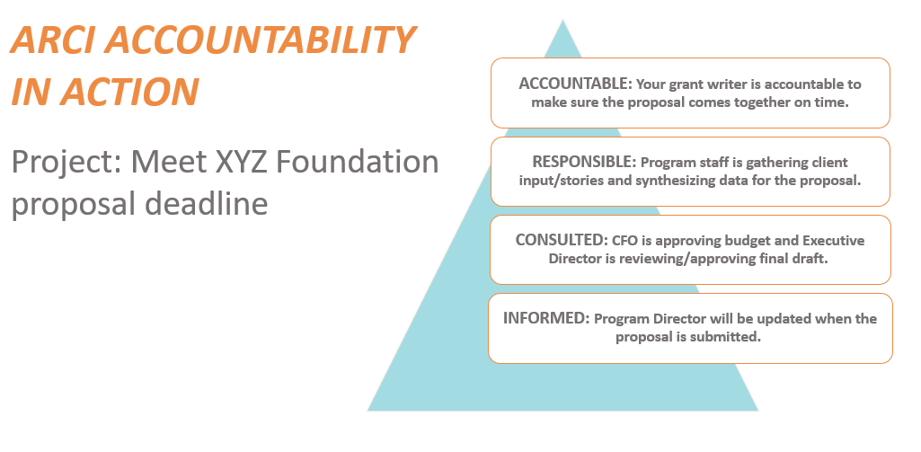
ARCI Accountability in Action
Notes:
KELLY
Here’s an example of the ARCI framework in action (read the example)
Accountable:
The individual responsible for writing your grants is accountable for making sure the proposal gets completed and submitted on time
Responsible:
One program staff member is gathering client input/stories for inclusion in the proposal to demonstrate past impact
Another program staff member is gathering and synthesizing the data needed for the proposal to help make the compelling case
Consulted:
CFO who is going to approve the budget being submitted with the proposal
Executive Director who is reviewing and approving the final version for submission
Informed:
Program director who will receive updates along the way and will be notified when the proposal has been submitted
You can apply this framework to any project that involves a team of people working toward a goal or objective, which gives the team a shared understanding of each person’s roles and contributions and helps ensure that the project moves forward as agreed to by the team.

Slide 13
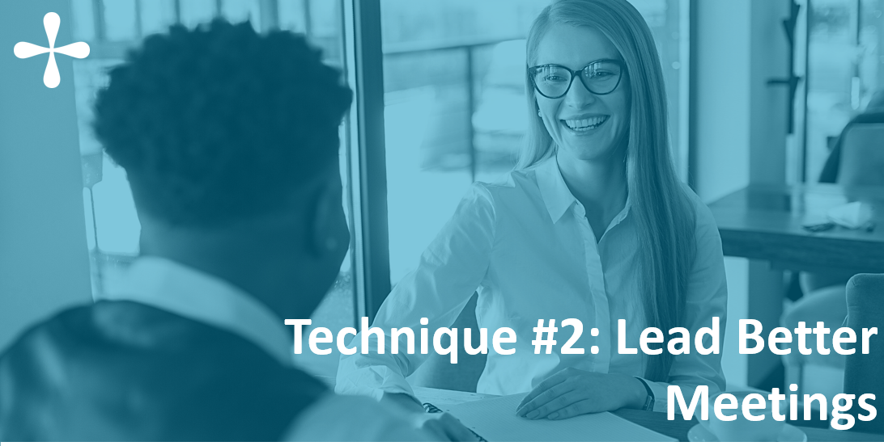
Notes:
ABBY
The second technique to help you manage up for successful grant seeking is learning how to lead better meetings.
As grants professionals, it’s likely that we not only attend A LOT of meetings,
Many times, we are leading meetings with program staff, executive staff, and colleagues at all levels of the organization.
We’ve probably all been in meetings that lack a clear purpose, or where our own role is not clearly defined. Raise your hand if you have been in some not-so-great meetings. We’ve all been there!
However, we know that a well-led meeting can be an effective tool for ensuring team members are on the same page and there is a shared sense of purpose.
You can use meetings to:
Unite program and leadership staff around a common goal
Reinforce staff accountabilities
Establish timelines for carrying out a project to completion.

Slide 14
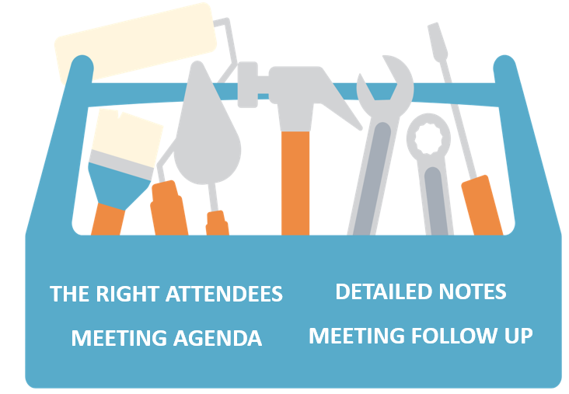
Tools for Successful Meetings
Notes:
ABBY
In order to have a successful meeting, you need the following tools in your chest:
The right attendees: The goal and content of the meeting should be applicable to each attendee. Think about who is instrumental in achieving the goal you have set for the meeting. The ARCI framework can help with this
Meeting agenda: Create an agenda with discussion items that support the overall goal of the meeting. Components of a good agenda include:
Introductions (if needed)
An opportunity for relevant updates (in our client meetings we start with organizational updates from our clients)
Items that support the goal of the meeting
Review of action items
Wrap up, which might include sharing the date of the next meeting or confirming next steps
Develop and share the agenda with attendees in advance. It can help to ground everyone in the agenda at the start of the meeting and keep the conversation on track once the meeting is underway. If you’re remote, consider screen sharing the agenda. If you’re meeting in person, bring hard copies.
Detailed notes: Have a designated note-taker and keep track of any action-items or questions that come up over the course of the conversation. Having one person focused on taking notes allows someone else to focus entirely on leading the conversation and actively listening to other attendees.
Having detailed notes will help you with the next step, which is meeting follow up. You can highlight action/to-do items by highlighting them in the meeting notes and assigning different colors to who is going to complete the action item for ease of follow up
The follow up communication after a meeting is critical to reinforcing the accountability framework we talked about earlier. As the meeting leader, it is your responsibility to reinforce and remind people what they agreed to do.

Slide 15
A Successful Meeting in Action
Goal: Confirm proposal projects for the coming month
Attendees
Executive Director
Chief Development Officer
Grant Writer/Manager
Agenda items:
Review proposal calendar
Review cultivation pipeline
Confirm proposal projects
Next steps:
Follow up with program staff
Notes:
ABBY
Let’s look at an example.
First, set the goal.
In this example, we are convening a meeting to confirm proposal writing projects for the coming month. Using the ARCI framework, we’ve determined that:
The Chief Development Officer is Accountable for ensuring the proposal pipeline is on track to meet the organization’s fundraising goal for the quarter
You (the Grant Writer) are responsible for submitting proposals on deadline.
The Executive Director should be consulted to confirm that proposal development plans align with the strategic direction of the organization.
Since the goal of the meeting is to confirm high level details – what proposals need to be completed to stay on goal, you decide that you will inform/consult the program staff about the proposal development plans that will require their input following the meeting.
You may have noticed that in this example, the grants manager is responsible, whereas the CDO is accountable. Your role in the ARCI framework may/will shift depending on the specific context/situation.
Based on the goal we want to achieve, we’ve created an agenda with the following action items:
Review proposal calendar
Review cultivation pipeline
Confirm proposal projects
By taking the time to think about the goal of the meeting, planning who should attend using the ARCI framework, creating an agenda to help the conversation stay on track, and then proactively communicating next steps, you are already increasing your chances of leading a successful meeting that achieves your purpose.

Slide 16
Notes:
KELLY
Coming out of a meeting like the example Abby just reviewed (or any meeting related to a grant opportunity), the next step is going to be gathering the data and information you need to complete the proposal.
Another technique for managing up is to identify what information you need and clearly communicate those needs to the people who can provide it
At Grants Plus, we call this a “data request” and we identify this as a formal, structured part of the grant-seeking/proposal development process with our clients

Slide 17
Data & Information Request
Efficient method for collecting information
Simple and direct
Identifies accountabilities
Outlines timelines/deadlines
Notes:
KELLY
Requests for information connect back to our SDR communication and ARCI framework
Streamlines the process for gathering the information you need
Simplifies your request and makes it very clear what you need
Also makes it clear who you need it from (identifying responsibilities)
And by when
Presents the request in an objective and reasonable manner

Slide 18
Outlining the Data Request
Review application guidelines
Identify what information you already have
What information is missing?
Outline the information needed
Who has the information you need?
Develop the data request
Simplify questions
Identify who is responsible
Set a (reasonable) deadline
Notes:
KELLY
The process we use for developing a data request includes:
First, reviewing the application guidelines; this is basic in proposal development – know the instructions and follow them
Identify the information you have and what’s missing that you’re going to need to gather
Create an outline of the missing information and identify who is most likely to have that information
Create the “data request”
We send these via email but could also be done in a meeting
The important thing with these requests is to ask questions simply
Identify who is responsible for providing which pieces of information
Set a (reasonable) deadline – one that gives those who are responsible enough time to gather good information for you, but also gives you enough time to develop a good draft after you receive the information (note that this timeline will change and vary based on the complexity/length of each proposal or project)

Slide 19
Sample: Data and Information Request
I logged into the application portal to preview the application. Here is an outline of the information I need you to provide for this request.
Programmatic and request questions (Chris):
How many people will the project serve in a 12-month period?
What are the 2-3 primary goals of the project?
How will you know the project is successful?
How much do you want to request (up to $20,000)?
Organizational and budget questions (Andrea):
How many full-time, part-time, volunteers, and others (interns, Vistas, AmeriCorp, etc.) do you have? Please provide the breakdown for each category.
How would you describe the organization’s current financial condition? Do you foresee any financial challenges in the future?
Please provide a copy of your current operating budget (the most recent we have on file is FY21).
Please provide a copy of your most recent audited financial statements (the most recent we have on file is FY20).
Please provide this information by Monday, November 7th. The application is due on Monday, November 14th.
Notes:
KELLY
This example shows that I need some programmatic information that is specific to the request and some more general organizational/budget information
Note that this is NOT the full application but just the information you need (not as overwhelming)
I have outlined the full application in a Word document that is my working version of a draft, but this tool only identifies that pieces that are missing
It separates the questions by programmatic vs. nonprogrammatic (grouping keeps it simple, streamlined; organized in a way that makes it more likely that nothing gets overlooked)
Identities WHO the questions/statements are directed to (in this example, Chris is responsible for answering program-related questions, and Andrea is responsible for addressing organizational and budget questions)
Questions/statements are simple and direct, not overly wordy or explanatory – to the point
Identifies a deadline for the information AND the application deadline (demonstrates that the request is reasonable – asking for information in advance of the application deadline to give yourself time to do your work, but not so far in advance that it seems unreasonable)
In this case, one week in advance gives the writer time to fill in these missing details and provide a draft for review/approval
Note that you can work on other portions of the application or proposal while you await the information that has been requested (don’t need to wait to begin until you have all the information)
Again, if this is a more complex proposal (federal government application, for example) you can adjust this timeline to give yourself a more realistic amount of time

Slide 20
Proposal Development
Having good, comprehensive data and information from the start leads to proposals that are:
Complete
Error-free
Clear and logical
Engaging
Persuasive and compelling
Inclusive of voices/conditions
Tailored to the funder
Notes:
KELLY
Final note about data requests and requesting information
Keeping your requests for information simple and streamlined is more likely to result in receiving good information from your colleagues.
And having good, comprehensive, complete data and information from the start gives you greater power to write the best possible proposal.
At Grants Plus, the best possible proposal is:
Complete – responsive to instructions/guidelines
Error-free – includes accurate data, budget figures, and has been edited for spelling/grammar
Clear and logical – clear and easy to read, easy for the reader to follow along and make sense of the proposal
Engaging – has a strong throughline, keeps the reader’s interest throughout
Persuasive and compelling - makes a strong case for need and how the organization or program will meet that need
Inclusive of voices/conditions – uses language that is respectful of people being served and portrays them how they want to be portrayed (rely on your program people to help with this, as they’re working directly with beneficiaries and will likely have a decent understanding of language and terms that are respectful; and can help describe the real conditions and barriers that they face)
Tailored to the funder – draws clear alignment between the organization’s work, the purpose of the request, and the funder’s priorities or interests

Slide 21
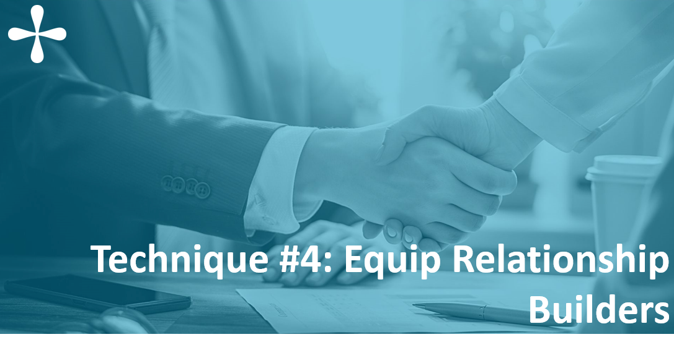
Notes:
ABBY
In order to tailor proposals to funders, steps should be taken in advance to build relationships with foundation staff and trustees.
Which brings us to the 4th technique
Grants professionals have the power to infuse the relationship building process with an intimate knowledge of both the organization’s programs and the funder’s priorities. By employing some simple strategies, we can set those doing the cultivation up for success.

Slide 22
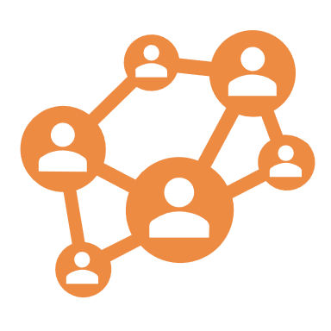
Create a Pulse & Practice for Strategy Support
Establish routines to set relationship builders up for success
Identify connections
Get clear on alignment
Develop talking points
Capture conversation outcomes
Document next steps
Notes:
ABBY
This can look like
Highlighting possible connections between the foundation board and your organization’s board – and then involving the person with the connection in doing the outreach
Making sure the person doing the outreach understands how the organization’s work aligns with the foundation’s grantmaking priorities
Providing talking points or email copy
Encourage the person having the conversation to provide feedback on the conversation and any relevant details that could impact the proposal development
Track next steps – maybe further conversation will be required, or perhaps the contact invited the organization to submit an LOI
We do this for our clients
We help them identify where they might have connections
We equip them with talking points
The fact that we’ve taken the time and effort to doing the brainwork for them takes something off their plate and makes it easier for them to fulfill their responsibility in the accountability framework

Slide 23
Stewardship
We know that successful stewardship:
Communicates gratitude
Builds trust
Enhances understanding of impact
Together, all of these deepen funder relationships
Use tools that help you leverage stewardship opportunities
Stewardship planner
Notes:
ABBY
As we know, relationship building is not just about cultivation. Stewardship is also a necessary part of this process.
Effective stewardship
Communicates gratitude
Builds trust
And enhances understanding of impact
Each of these outcomes of effective stewardship ultimately deepen an organization’s relationship with a funder
Just like in the cultivation process, there are strategies and tools you can use to build efficiencies into this process and set your organization up for success (such as a stewardship planner)

Slide 24
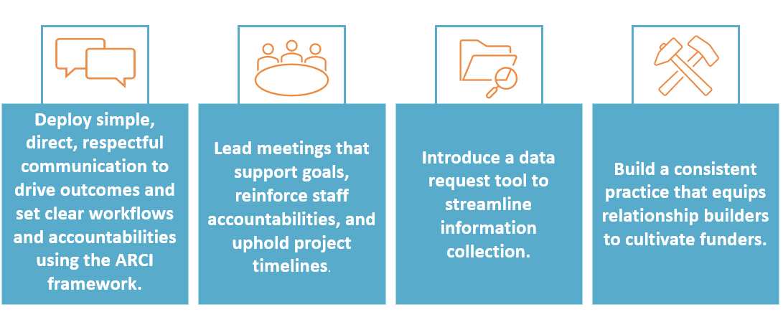
Key Takeaways to Manage Up
Notes:
KELLY
Utilizing these tools for managing up and driving cross-team efficiency can set you up for success in your grant-seeking efforts
Using simple, direct, respectful communication techniques and identifying accountabilities using the ARCI framework
Leading effective meetings that build shared understanding of goals and identify accountabilities/responsibilities/next steps
Using a streamlined process for gathering good, clear information to inform the development of grant proposals
Engaging in a consistent practice to build and cultivate relationships with funders (and especially understanding how you as the grant professional can fit into that practice if it’s not a defined or natural part of your role)
Our hope is that by using these techniques, you can feel empowered to have influence and accept accountabilities even in situations where you don’t necessarily have POWER, which is a common challenge for many grant professionals.
These are tools and techniques that you can employ immediately – and then leverage them to lead teams in the right direction
Because the reality is that you can’t control other people or force them to participate, but can influence them, build trust and buy-in from them, and lead them from behind
We believe this makes our work with our clients easier and produces better products, and we believe it can make your job easier too

Slide 25
Notes:
Does any of this resonate with you? If so, which part?
What other tips and techniques have you used that have been successful in managing up?
Is anyone willing to share an example of a time when you were accountable but didn’t have the tools you needed to “manage up?”
What did you do in that situation?
What could you do differently using some of these techniques?

Slide 26
info@grantsplus.com
Connect with us on LinkedIn!
@ Grants Plus
@ Abby Teare
@ Kelly Howard
www.grantsplus.com

